Slide 1
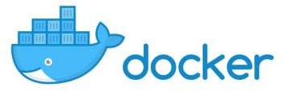
Introduction to Docker

Slide 2
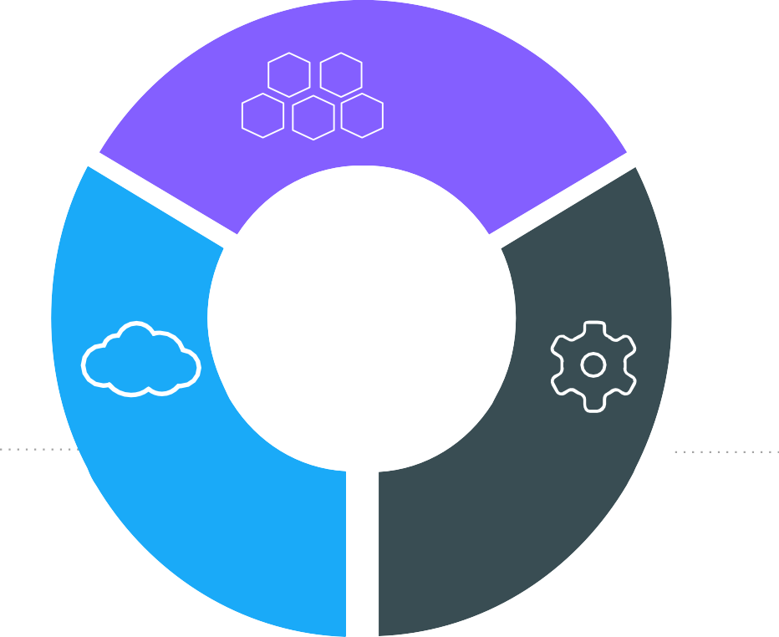
The IT Landscape is Changing
Apps
Cloud
DevOps

Slide 3
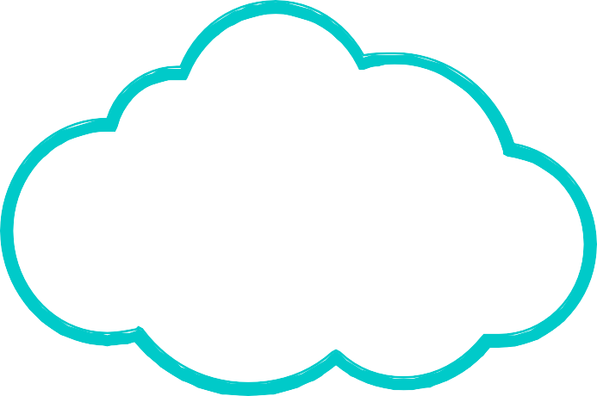
Movement in the cloud
Migrate workloads to cloud
80%
Portability across environments
Want to avoid cloud vendor lock-in
State of App development Survey: Q1 - 2016

Slide 4














Applications are transforming
~2000
Today
Loosely Coupled Services
Monolithic
Rapidly updated
Slow changing
Many Small
Servers or devices
Big Servers

Slide 5
Application Modernization
Application Code
Developer Issues:
Microservices: Break application into separate operations
Minor code changes require full re-compile and re-test
Application becomes single point of failure
Application is difficult to scale
12-Factor Apps: Make the app independently scalable, stateless, highly available by design

Slide 6










Continuous Integration and Delivery
1. Development 2. Test 3. Stage / Production
Version control
Sysadmin
Developer
QA / QE

Slide 7
Tug of War Between Developers and Ops
Developers
IT Operations
Freedom to create and deploy apps fast
Define and package application needs
Quickly and flexibly respond to changing needs
Standardize, secure, and manage

Slide 8

Organizations Must Deal with Diverse Technology
Bare Metal
Virtual
On Premises
Cloud
Linux
Windows
Traditional
Microservices

Slide 9
…and Diverse Organizations
Developers
IT Operations
Freedom to create and deploy apps fast
Define and package application needs
Quickly and flexibly respond to changing needs
Standardize, secure, and manage

Slide 10
The Myth of Bi-Modal IT
 | MICROSERVICES | TRADITIONAL APPS
Cloud or New Infrastructure | You are either here..
Old Infrastructure |  | …or here

Slide 11





Enabling a Journey
 | MICROSERVICES | AGILE TRADITIONAL APPS | TRADITIONAL APPS
Cloud or New Infrastructure
Old Infrastructure
…that is past AND future proof

Slide 12
Docker and Container Overview

Slide 13
History of Docker
2013
Solomon Hykes starts Docker as an internal project within dotCloud
Feb 2016
Docker introduces first commercial product – now called Docker Enterprise Edition
2008
Linux containers
(LXC 1.0)
introduced
Mar 2013
Docker released to open source
Today
Open source community includes:
2004
Solaris Containers / Zones technology introduced
- 3,300+ contributors
- 43,000+ stars
- 12,000+ forks

Slide 14
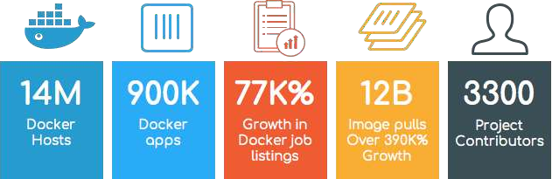
Incredible adoption in just 4 years

Slide 15


The Docker Family Tree
Subscription-based, commercially supported products for delivering a secure software supply chain
Enterprise Edition
Intended for:
Production deployments + Enterprise customers
Open source framework for assembling core components that make a container platform
Free, community-supported product for delivering a container solution
Intended for:
Open source contributors + ecosystem developers
Community Edition
Intended for: Software dev & test

Slide 16
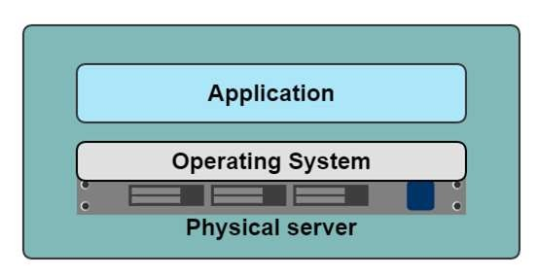
A History Lesson
In the Dark Ages
One application on one physical server

Slide 17
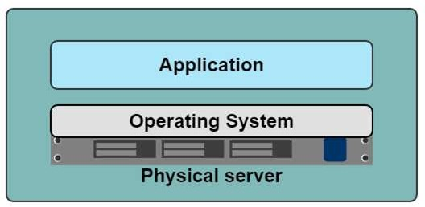
Historical limitations of application deployment
Slow deployment times
Huge costs
Wasted resources
Difficult to scale
Difficult to migrate
Vendor lock in
17

Slide 18
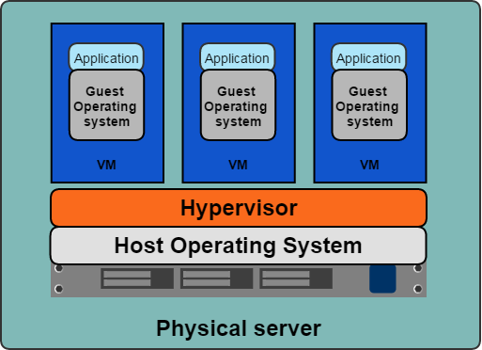
A History Lesson
Hypervisor-based Virtualization
One physical server can contain multiple applications
Each application runs in a virtual machine (VM)

Slide 19



Benefits of VMs
Better resource pooling
One physical machine divided into multiple virtual machines
Easier to scale
VMs in the cloud
Rapid elasticity
Pay as you go model

Slide 20



Limitations of VMs
Each VM stills requires
CPU allocation
Storage
RAM
An entire guest operating system
The more VMs you run, the more resources you need
Guest OS means wasted resources
Application portability not guaranteed

Slide 21
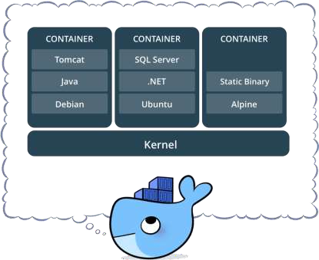
What is a container?
Standardized packaging for software and dependencies
Isolate apps from each other
Share the same OS kernel
Works with all major Linux and Windows Server

Slide 22
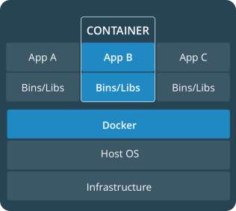
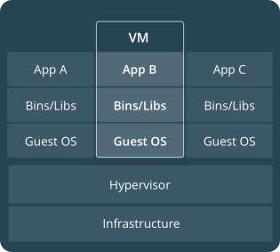
Comparing Containers and VMs
Containers are an app level construct
VMs are an infrastructure level construct to turn one machine into many servers

Slide 23
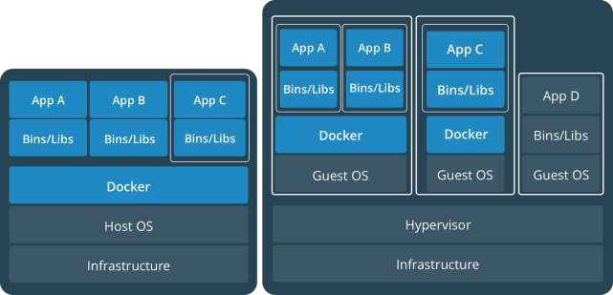
Containers and VMs together
PROD
DEV
Containers and VMs together provide a tremendous amount of
flexibility for IT to optimally deploy and manage apps.

Slide 24
Key Benefits of Docker Containers
Speed
No OS to boot = applications online in seconds
Portability
Less dependencies between process layers = ability to move between infrastructure
Efficiency
Less OS overhead
Improved VM
density

Slide 25
Container Solutions & Landscape

Slide 26




Docker Basics
Image
The basis of a Docker container. The content at rest.
Container
The image when it is ‘running.’ The standard unit for app service
Engine
The software that executes commands for containers. Networking and volumes are part of Engine. Can be clustered together.
Registry
Stores, distributes and manages Docker images
Control Plane-Docker EE,K8s
Management plane for container and cluster orchestration

Slide 27
Foundation: Docker Engine
Integrated Security
Security | Network | Volumes
Distributed State | Container Runtime | Orchestration
Docker Engine

Slide 28













DEVELOPERS
IT OPERATIONS
Microservices
Traditional

Slide 29

Building a Software Supply Chain
DEVELOPERS
Image Registry
IT OPERATIONS
Microservices
Control Plane
Traditional

Slide 30













Containers as a Service
Developers
IT Operations
BUILD
Development Environments
SHIP
Secure Content & Collaboration
RUN
Deploy, Manage, Scale
Control plane
Registry
Multi-container apps
Engines running on servers in cloud or datacenter
Clients pull and push images
Images stored in repos

Slide 31

Building a Secure Supply Chain
Container App Lifecycle Workflow
Private Image Registry | Secure Access and User Management | Application and Cluster Management
Image Scanning and Monitoring Security | Content Trust and Verification Network | Policy Management
 |  | Volumes
Distributed State | Container Runtime | Orchestration
Enterprise Edition
Docker Engine
Usable Security
Trusted Delivery
Portable

Slide 32
Docker Enterprise Edition

Slide 33

3 out 4
Docker Aligns to Multiple IT Initiatives
Apps
Top initiatives are app
modernization
80%
Looking at Docker for
Cloud Strategy
44%
Looking to adopt DevOps with Docker
Cloud
DevOps
State of App development Survey: Q1 2016

Slide 34










Docker Is in the Enterprise
Service Provider
Healthcare & Science
Financial Services
Tech
Insurance
Public Sector

Slide 35
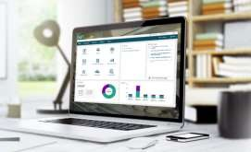

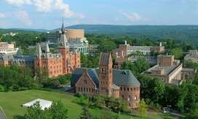


Docker delivers agility, security and cost savings
Hardened containers deliver new levels of security to monoliths on the transition to microservices
Transform monoliths to secure and agile DevOps environments
Reduce maintenance costs by 10X for legacy, commercial and new apps

Slide 36
Docker delivers agility, resiliency, portability security and cost savings for all applications
Commercial Off The Shelf Apps
Homegrown Traditional Apps
Microservices Apps
13X
More software releases
65%
Reduction in developer onboarding time
~47%
Reduction in VMs, OS licensing and Server costs
Eliminate
“works on my machine”
issues
62%
Report reduction in MTTR
10X
Cost reduction in maintaining existing applications

Slide 37







One platform and one journey for all applications
1
Traditional apps in containers
Gain portability, efficiency and security
2
Transform to Microservices
Look for shared services to transform
3
Accelerate New Applications
Greenfield innovation

Slide 38
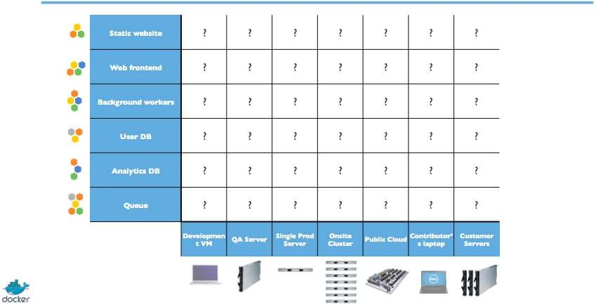
Multiple Stacks, Multiple Stages = Complexity

Slide 39
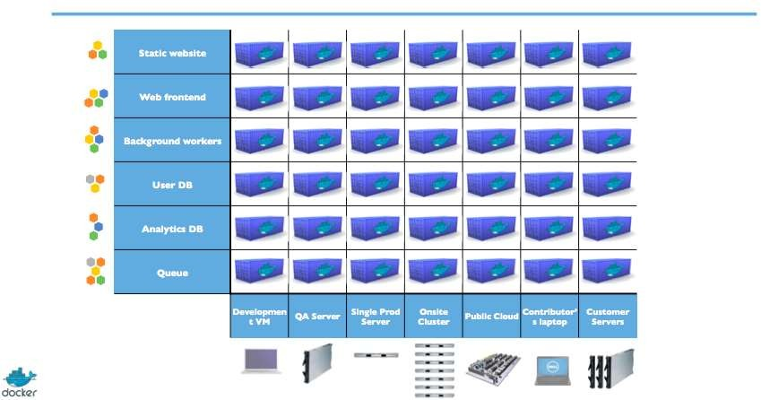
Solving the deployment matrix

Slide 40
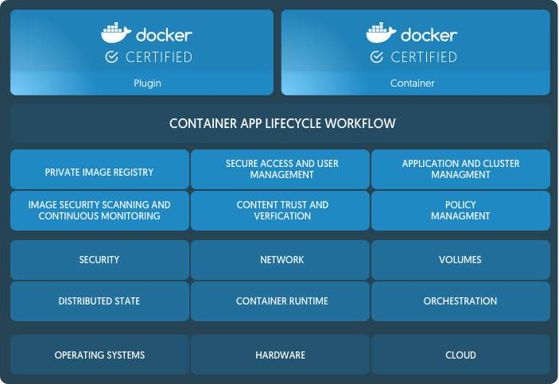
Docker Enterprise Edition (EE) is the CaaS enabled platform for developers and IT
Integrated orchestration, security and
management
Predictable quarterly releases with one year of support and maintenance
Security patches and hotfixes backported
to all supported versions
Enterprise class support (9am-6pm or 24x7x365)
Certified Infrastructure, Containers and Plugins

Slide 41












Certified technology extend the platform with assurances and support

